Slide 1
Unit 3
Foundations of Data Science

Slide 2
Introduction to NumPy
NumPy is a Python package which stands for 'Numerical Python’.
It is a library consisting of multidimensional array objects and a collection of routines for processing of array.
Operations using NumPy
Using NumPy, a developer can perform the following operations −
Mathematical and logical operations on arrays.
Fourier transforms and routines for shape manipulation.
Operations related to linear algebra. NumPy has in-built functions for linear algebra and random number generation

Slide 3
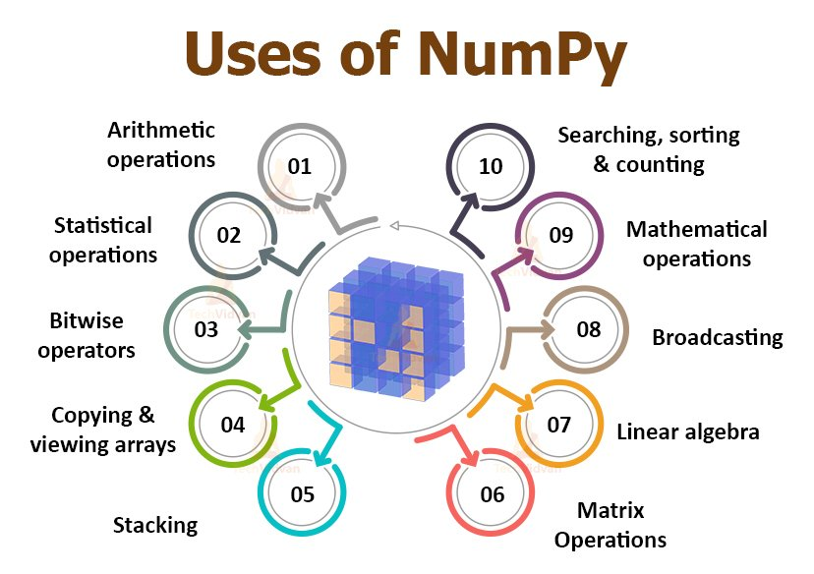
Introduction to NumPy

Slide 4
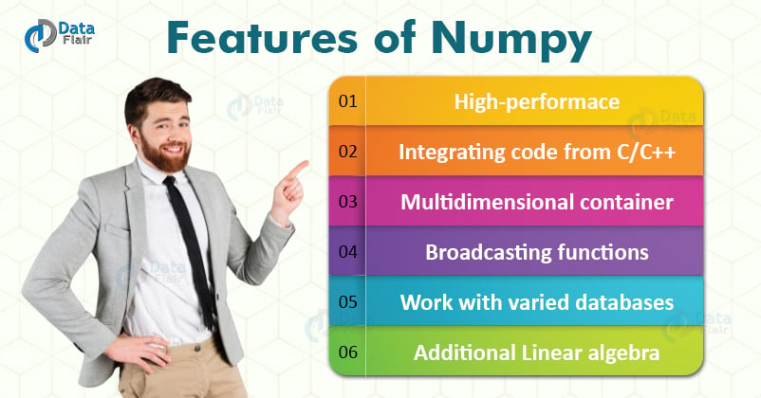

Slide 5
Installing NumPy
If you already have python, NumPy can be installed with pip install numpy .r
Name>pip install numpy
If you don’t have python yet, you might want to consider using Anaconda. Anaconda is the easiest way to get started and has all the major packages pre-installed.
PIP is a package management system used to install and manage software packages written in Python.
It stands for “preferred installer program”.
PIP for Python is a utility to manage PyPI package installations from the command line.

Slide 6
Importing NumPy
To use any package or library in your code, it needs to be made accessible.
We can start using NumPy and its available functionalities using the import statement: import numpy as np
We import it as np to save time and for standardization of the code.

Slide 7
NumPy Array vs. Python Lists
NumPy is an alternative for lists in Python as it holds less memory, has faster processing, and is more convenient to use.
The difference between the elements is that the NumPy array has to be homogenous.
We can maintain homogeneity for the efficient application of the mathematical functions.
Arrays in NumPy are more compact when we compare it to lists and the data type specification which leads to code optimization.

Slide 8
Pandas
Pandas is an open-source Python Library providing high-performance data manipulation and analysis tools using its powerful data structures.
Pandas is a Python library used for working with data sets.
It has functions for analyzing, cleaning, exploring, and manipulating data.
The name "Pandas" has a reference to both "Panel Data", and "Python Data Analysis" and was created by Wes McKinney in 2008.

Slide 9
Pandas
Prior to Pandas, Python was majorly used for data munging and preparation. It had very little contribution towards data analysis. Pandas solved this problem.
Using Pandas, we can accomplish five typical steps in the processing and analysis of data, regardless of the origin of data — load, prepare, manipulate, model, and analyze.
Python with Pandas is used in a wide range of fields including academic and commercial domains including finance, economics, Statistics, analytics, etc.

Slide 10
Why Use Pandas?
Pandas allow us to analyze big data and make conclusions based on statistical theories.
Pandas can clean messy data sets, and make them readable and relevant.
Relevant data is very important in data science.

Slide 11
Key Features of Pandas
Fast and efficient DataFrame object with default and customized indexing.
Tools for loading data into in-memory data objects from different file formats.
Data alignment and integrated handling of missing data.
Reshaping and pivoting of data sets.
Label-based slicing, indexing, and subsetting of large data sets.
Columns from a data structure can be deleted or inserted.
Group by data for aggregation and transformations.
High-performance merging and joining of data.
Time Series functionality

Slide 12
Installation of Pandas
If you have Python and PIP already installed on a system, then Install it using the command:
C:\>pip install pandas
Import Pandas
Once Pandas is installed, import it in your applications by adding the import keyword:
Import pandas
Checking Pandas Version
import pandas as pd
print(pd.__version__)

Slide 13
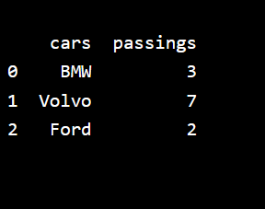
Example ---
import pandas as pd
mydataset = { 'cars': ["BMW", "Volvo", "Ford"],
'passings': [3, 7, 2]
}
myvar = pd.DataFrame(mydataset)
print(myvar) Output:

Slide 14
Data Structures in Pandas
Pandas deals with the following three data structures −
Series
DataFrame
Panel

Slide 15
Data Structures in Pandas
These data structures are built on top of NumPy array, which means they are fast.
The best way to think of these data structures is that the higher dimensional data structure is a container of its lower dimensional data structure.
For example, DataFrame is a container of Series, Panel is a container of DataFrame.
All Pandas data structures are value mutable (can be changed) and except Series, all are size mutable.
Series is size immutable.
DataFrame is widely used and one of the most important data structures. Panel is used much less

Slide 16
Series in Pandas
A Pandas Series is like a column in a table.
It is a one-dimensional array holding data of any type.
Example:
import pandas as pd
a = [1, 7, 2]
myvar = pd.Series(a)
print(myvar)
OUTPUT
0 1
1 7
2 2
dtype: int64

Slide 17
Labels
The values are labeled with their index number. The first value has an index 0, second value has an index 1 etc. This label can be used to access a specified value.
Example---
import pandas as pd
a = [1, 7, 2]
myvar = pd.Series(a)
print(myvar[0])
Output
1

Slide 18
Create Labels
With the index argument, you can name your own labels.
import pandas as pd
a = [1, 7, 2]
myvar = pd.Series(a, index = ["x", "y", "z"])
print(myvar)
Output
x 1
y 7
z 2
dtype: int64

Slide 19
Key/Value Objects as Series
Example
Create a simple Pandas Series from a dictionary:
import pandas as pd
calories = {"day1": 420, "day2": 380, "day3": 390}
myvar = pd.Series(calories)
print(myvar)
OUTPUT
day1 420
day2 380
day3 390
dtype: int64

Slide 20
Example
Create a Series using only data from "day1" and "day2“—
import pandas as pd
calories = {"day1": 420, "day2": 380, "day3": 390}
myvar = pd.Series(calories, index = ["day1", "day2"])
print(myvar)
OUTPUT
day1 420
day2 380
dtype: int64

Slide 21
Pandas: DataFrame
A Data frame is a two-dimensional data structure, i.e., data is aligned in a tabular fashion in rows and columns.
Features of DataFrame:
Potentially columns are of different types
Size – Mutable
Labeled axes (rows and columns)
Can Perform Arithmetic operations on rows and columns

Slide 22
Pandas: DataFrame
A pandas DataFrame can be created using various inputs like −
Lists
dict
Series
Numpy ndarrays
Another DataFrame

Slide 23
Pandas: DataFrame
Example-- Create a DataFrame from two Series:
import pandas as pd
data = {
"calories": [420, 380, 390],
"duration": [50, 40, 45]
}
myvar = pd.DataFrame(data)
print(myvar)
OUTPUT
calories duration
0 420 50
1 380 40
2 390 45

Slide 24
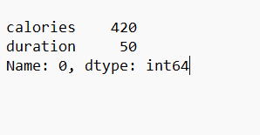
Locate Row (loc)
The DataFrame is like a table with rows and columns. Pandas use the loc attribute to return one or more specified row(s)
Example ---- Return row 0:
import pandas as pd
data = {
"calories": [420, 380, 390],
"duration": [50, 40, 45]
}
#load data into a DataFrame object: OUTPUT
df = pd.DataFrame(data)
print(df.loc[0])

Slide 25
Load Files Into a DataFrame
If your data sets are stored in a file, Pandas can load them into a DataFrame.
Example
import pandas as pd
df = pd.read_csv('data.csv')
print(df)
#use to_string() to print the entire DataFrame.
#print(df.to_string())

Slide 26
max_rows
You can check your system's maximum rows with the pd.options.display.max_rows statement.
import pandas as pd
print(pd.options.display.max_rows)

Slide 27
Pandas - Analyzing DataFrames
Viewing the Data
The head() method returns the headers and a specified number of rows, starting from the top.
The tail() method returns the headers and a specified number of rows, starting from the bottom.
# by default 5 rows are shown
Example:
import pandas as pd
df = pd.read_csv('data.csv')
print(df.head(10))
print(df.tail())
print(df.info()) # print information about dataset

Slide 28
Pandas: Statistical Analysis
A large number of methods collectively compute descriptive statistics and other related operations on DataFrame.
Most of these are aggregations like sum(), mean(), but some of them, like sumsum(), produce an object of the same size.
Generally speaking, these methods take an axis argument, just like ndarray.{sum, std, ...}, but the axis can be specified by name or integer

Slide 29
Matplotlib
Matplotlib is a low-level graph plotting library in python that serves as a visualization utility. Most popular python package for Data Visualisation.
Matplotlib was created by John D. Hunter.
Matplotlib is open source and we can use it freely.
Matplotlib is mostly written in Python, a few segments are written in C, Objective-C, and Javascript for Platform compatibility.
It is a cross-platform library for making 2D plots from data in arrays.

Slide 30
Matplotlib
It provides an object-oriented API that helps in embedding plots in applications using Python GUI toolkits such as PyQt, WxPythonotTkinter.
It can be used in Python and IPython shells, Jupyter notebook and web application servers also.
Matplotlib has a procedural interface named the Pylab, which is designed to resemble MATLAB, a proprietary programming language developed by MathWorks.
.

Slide 31
Matplotlib Dependencies
Matplotlib requires a large number of dependencies −
Python (>= 2.7 or >= 3.4)
NumPy
setuptools
dateutil
pyparsing
libpng
pytz
FreeType
cycler
six

Slide 32
Matplotlib PyLab Module
PyLab is a procedural interface to the Matplotlib object-oriented plotting library.
Matplotlib is the whole package; matplotlib.pyplot is a module in Matplotlib; and PyLab is a module that gets installed alongside Matplotlib.
PyLab is a convenience module that bulk imports matplotlib.pyplot (for plotting) and NumPy (for Mathematics and working with arrays) in a single name space.

Slide 33
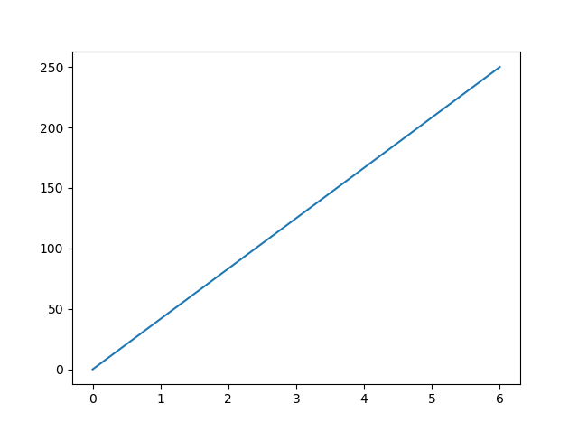
Matplotlib Pyplot: Basic Plotting
Most of the Matplotlib utilities lies under the pyplot submodule.
Example --Draw a line in a diagram from position (0,0) to position (6,250):
Output
import matplotlib.pyplot as plt
import numpy as np
xpoints = np.array([0, 6])
ypoints = np.array([0, 250])
plt.plot(xpoints, ypoints)
plt.show()
#Plotting without line --To plot only the markers, you can use shortcut string notation parameter 'o', which means 'rings’.
#plt.plot(xpoints, ypoints, 'o')

Slide 34
SciPy Introduction
SciPy is a scientific computation library that uses NumPy underneath.
SciPy stands for Scientific Python.
It provides more utility functions for optimization, stats and signal processing.
Like NumPy, SciPy is open source so we can use it freely. Together, they run on all popular operating systems, are quick to install and are free of charge.
SciPy was created by NumPy's creator Travis Olliphant.
NumPy and SciPy are easy to use, but powerful enough to depend on by some of the world's leading scientists and engineers.
SciPy has optimized and added functions that are frequently used in NumPy and Data Science.

Slide 35
Import SciPy
Once SciPy is installed, import the SciPy module(s) you want to use in your applications by adding the from scipy import module statement
from scipy import constants
Example 1--- How many cubic meters are in one liter:
from scipy import constants
print(constants.liter)
Output: 0.001
Example 2
from scipy import constants
print(constants.pi)
Output: 3.141592653589793

Slide 36
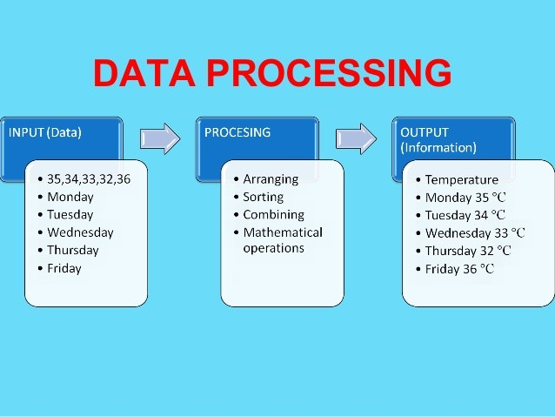
Data Processing
Data processing is the collection and manipulation of data to produce meaningful information.
Data processing is a form of information processing, which is the modification of information in any manner detectable by an observer

Slide 37
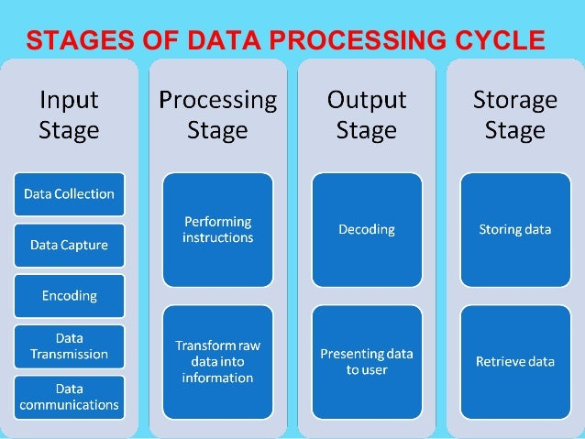
Stages of Data Processing Cycle

Slide 38
Data Visualization
Data visualization is the discipline of trying to understand data by placing it in a visual context so that patterns, trends, and correlations that might not otherwise be detected can be exposed.
Data visualization in Python is perhaps one of the most utilized features for data science with Python in today’s day and age.
The libraries in Python come with lots of different features that enable users to make highly customized, elegant, and interactive plots.
Python offers several plotting libraries, namely Matplotlib, Seaborn, and many other such data visualization packages with different features for creating informative, customized, and appealing plots to present data in the most simple and effective way.

Slide 39
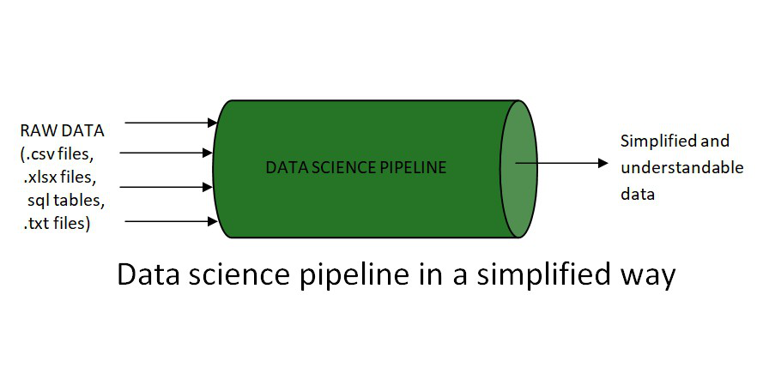
Data Science Pipeline

Slide 40
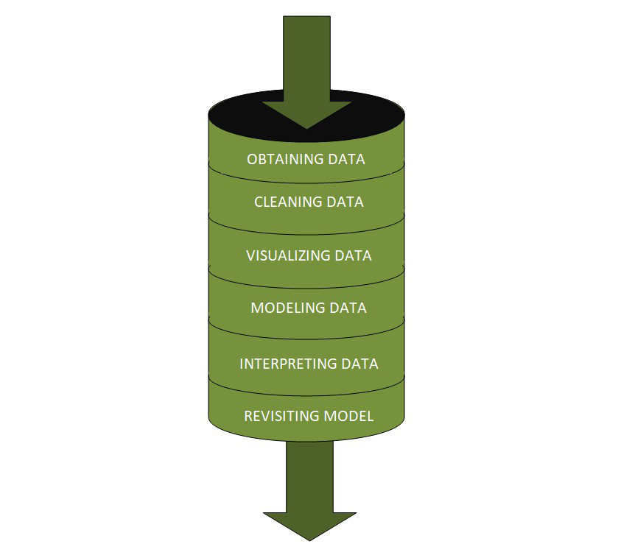
The raw data undergoes different stages within a pipeline, which are :-
Fetching/Obtaining the Data
Scrubbing/Cleaning the Data
Data Visualization
Modeling the Data
Interpreting the Data
Revision

Slide 41
Data Visualization
Data visualization is the graphical representation of information and data in a pictorial or graphical format(Example: charts, graphs, and maps).
Data visualization tools provide an accessible way to see and understand trends, patterns in data, and outliers.
Data visualization tools and technologies are essential to analyzing massive amounts of information and making data-driven decisions.
The concept of using pictures is to understand data that has been used for centuries.
General types of data visualization are Charts, Tables, Graphs, Maps, Dashboards.

Slide 42
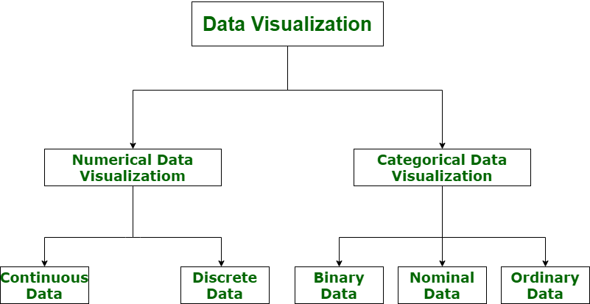
Categories of Data Visualization

Slide 43
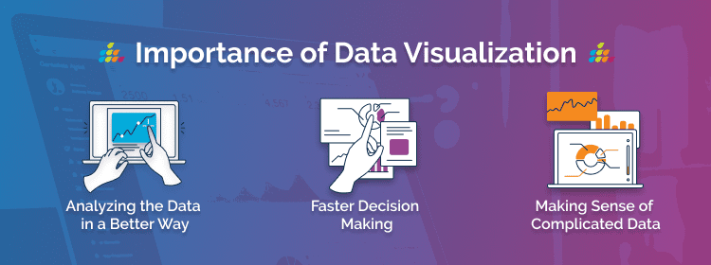
Importance of Data Visualization

Slide 44
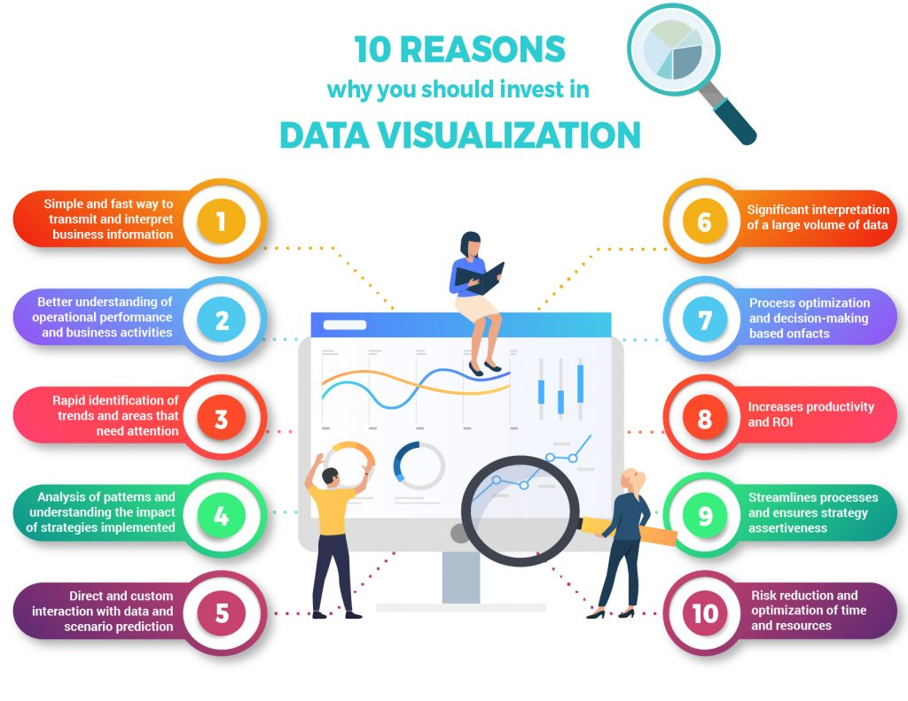
Data Visualization Need

Slide 45
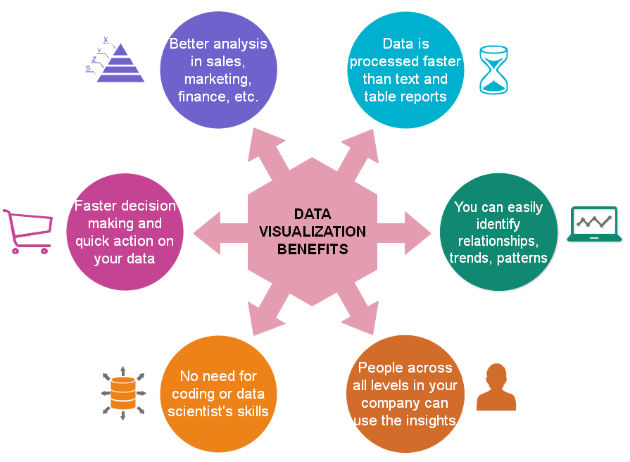
Data Visualization Need

Slide 46
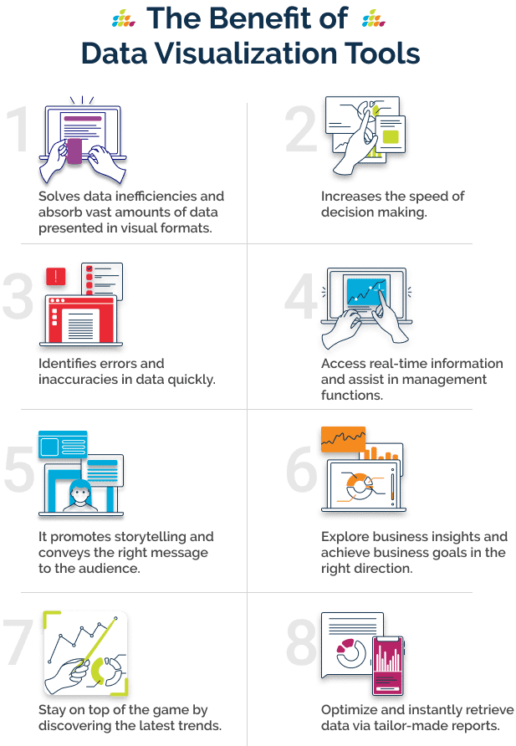
Need for Data Visualization Tools

Slide 47
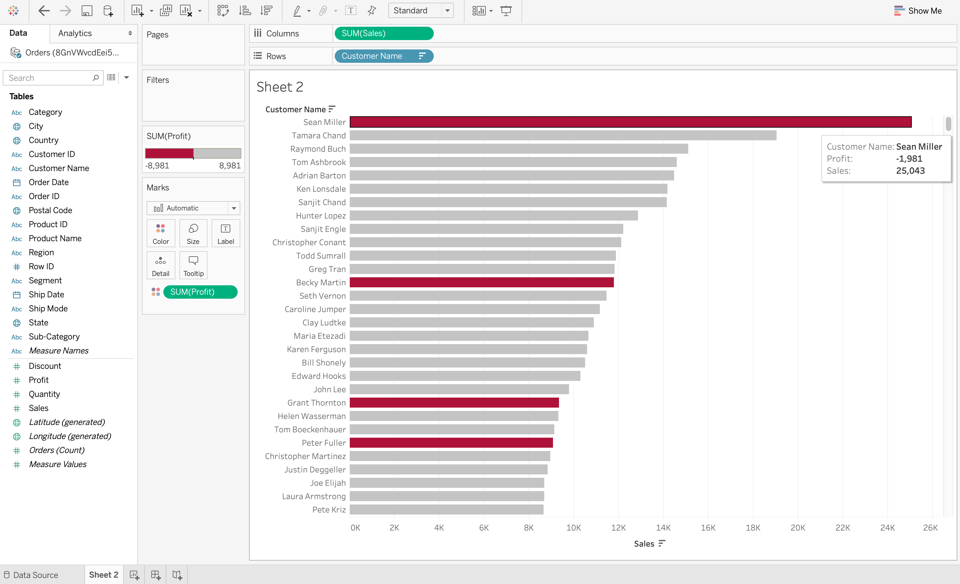
Why is Data Visualization Important?
Data Visualization Discovers the Trends in Data –
Tableau demonstrates the sum of sales made by each customer in descending order. However, the color red denotes loss while grey denotes profits.
So it is very easy to observe from this visualization that even though some customers may have huge sales, they are still at a loss.

Slide 48
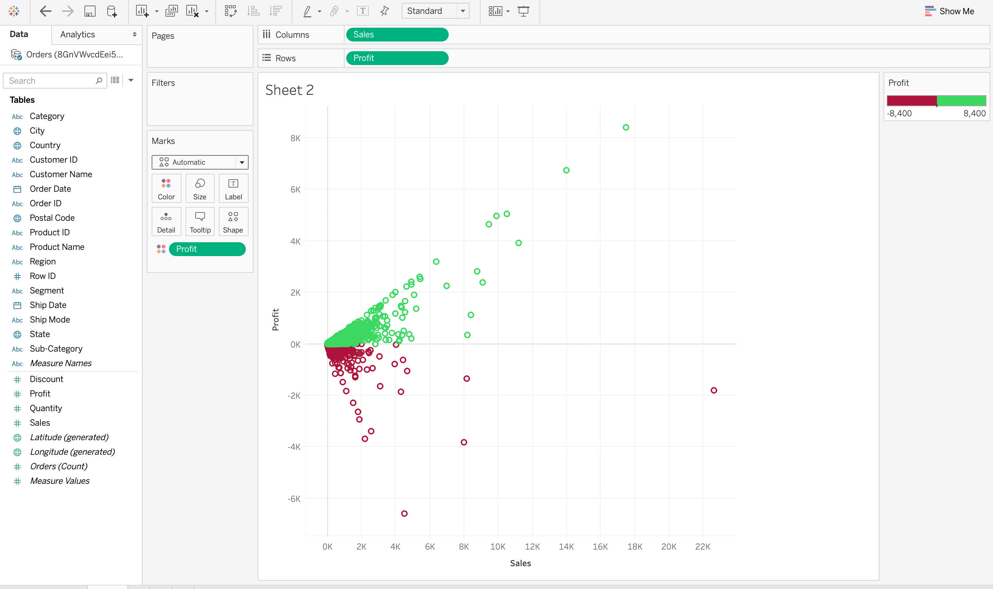
Why is Data Visualization Important?
Data Visualization Provides a Perspective on the Data -
Data visualization shows that the data between sales and profit provides a data perspective with respect to these two measures.
It also demonstrates that there are very few sales above 12K and higher sales do not necessarily mean a higher profit.

Slide 49
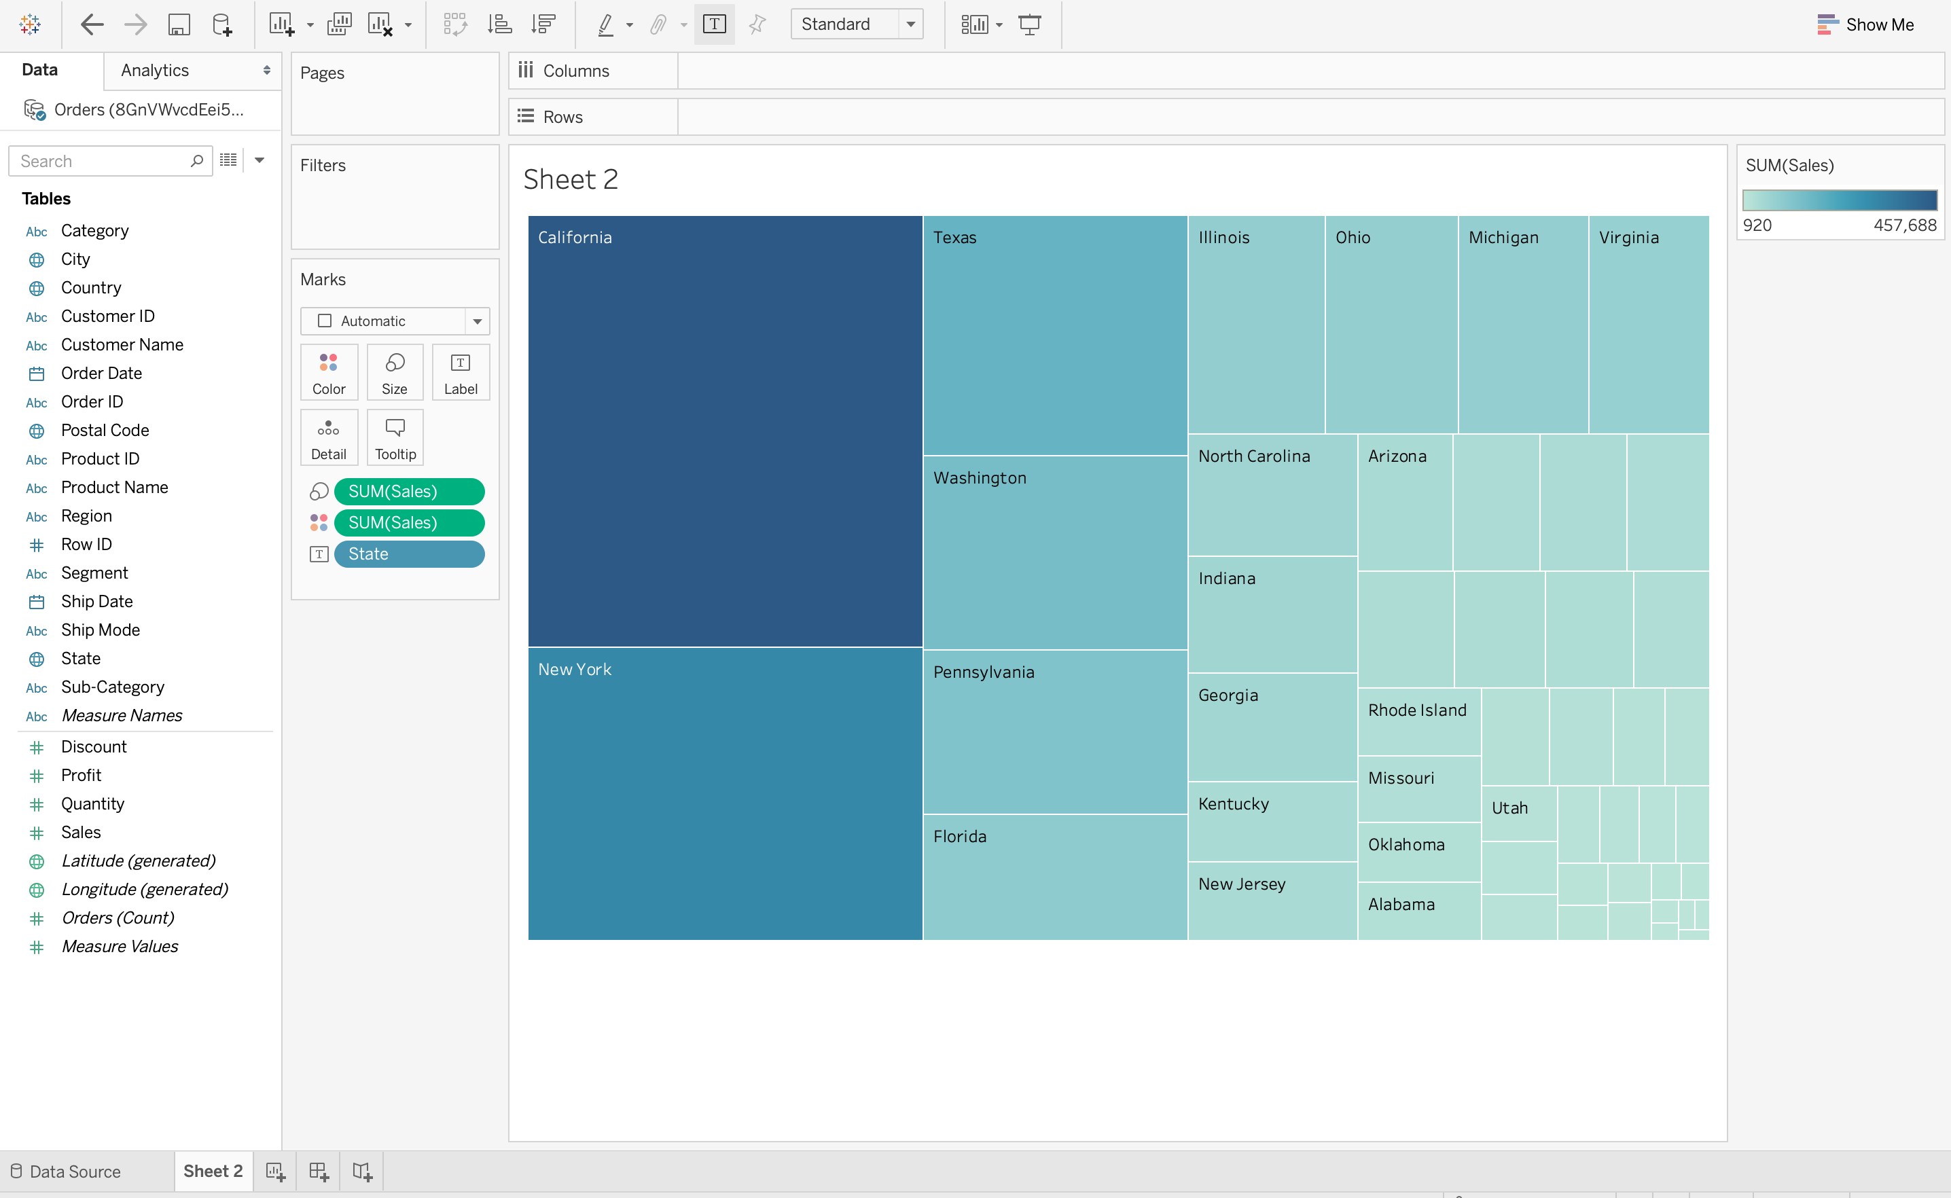
Why is Data Visualization Important?
Data Visualization Puts the Data into the Correct Context –
Data visualization on Tableau, a TreeMap is used to demonstrate the number of sales in each region of the United States.
It is very easy to understand from this data visualization that California has the largest number of sales out of the total number since the rectangle for California is the largest.
But this information is not easy to understand outside of context without data visualization.

Slide 50
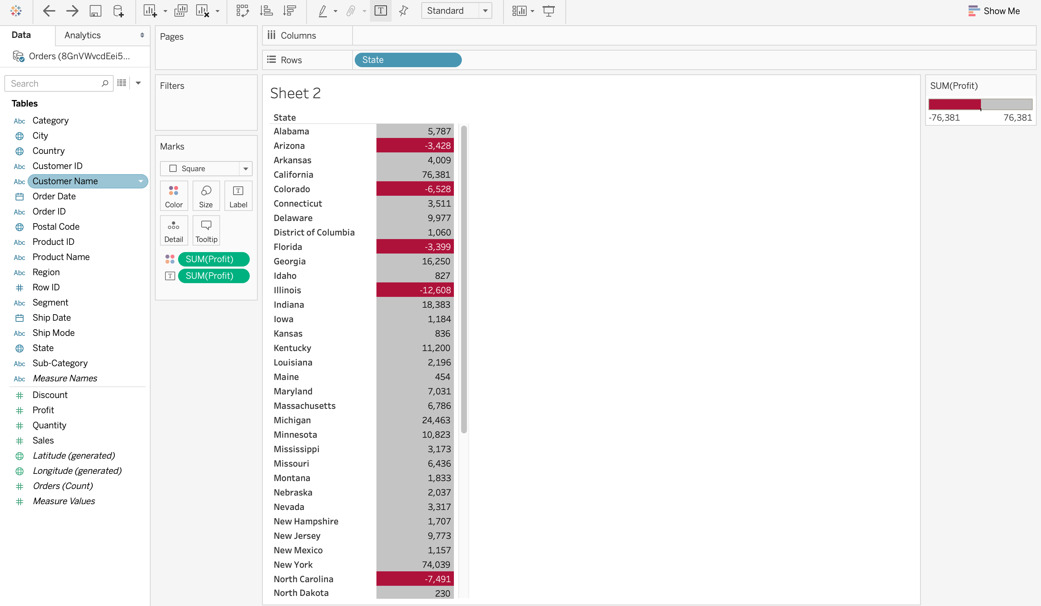
Why is Data Visualization Important?
Data Visualization Saves Time—
In this screenshot on Tableau, it is very easy to identify the states that have suffered a net loss rather than a profit. This is because all the cells with a loss are colored red using a heat map, so it is obvious states have suffered a loss. Compare this to a normal table where you would need to check each cell to see if it has a negative value to determine a loss. Obviously, data visualization saves a lot of time in this situation!

Slide 51
Why is Data Visualization Important?
Data Visualization Tells a Data Story -- Data visualization is also a medium to tell a data story to the viewers
For example, if a data analyst has to craft a data visualization for company executives detailing the profits on various products, then the data story can start with the profits and losses of various products and move on to recommendations on how to tackle the losses.

Slide 52
Top Data Visualization Tools
1. Tableau
One of the most widely used data visualization tools, Tableau, offers interactive visualization solutions to more than 57,000 companies.
Providing integration for advanced databases, including Teradata, SAP, My SQL, Amazon AWS, and Hadoop, Tableau efficiently creates visualizations and graphics from large, constantly-evolving datasets used for artificial intelligence, machine learning, and Big Data applications.
The Pros of Tableau:
Excellent visualization capabilities
Easy to use
Top class performance
Supports connectivity with diverse data sources
Mobile Responsive
Has an informative community
The Cons of Tableau:
The pricing is a bit on the higher side
Auto-refresh and report scheduling options are not available

Slide 53
Top Data Visualization Tool
2. Dundas BI
Dundas BI offers highly-customizable data visualizations with interactive scorecards, maps, gauges, and charts, optimizing the creation of ad-hoc, multi-page reports.
By providing users full control over visual elements, Dundas BI simplifies the complex operation of cleansing, inspecting, transforming, and modeling big datasets.
The Pros of Dundas BI:
Exceptional flexibility
A large variety of data sources and charts
Wide range of in-built features for extracting, displaying, and modifying data
The Cons of Dundas BI:
No option for predictive analytics
3D charts not supported

Slide 54
Other Significant Data Visualization Tools
Excel
(Basic to Advanced Analytics)
QlikView
Microsoft Power BI
Datawrapper
Plotly
Sisense
Zoho analytics

Slide 55
Seaborn for Plotting
Seaborn is a library that uses Matplotlib underneath to plot graphs. It will be used to visualize random distributions.
Plotly's Python graphing library makes interactive, publication-quality graphs online.
This graph is mainly used when we want to make line plots, scatter plots, area charts, bar charts, error bars, box plots, histograms, heatmaps, subplots, multiple-axes, polar charts, and bubble charts.
Seaborn is a library for making statistical graphics in Python. It is built on top of matplotlib and it is integrated with pandas data structures.

Slide 56
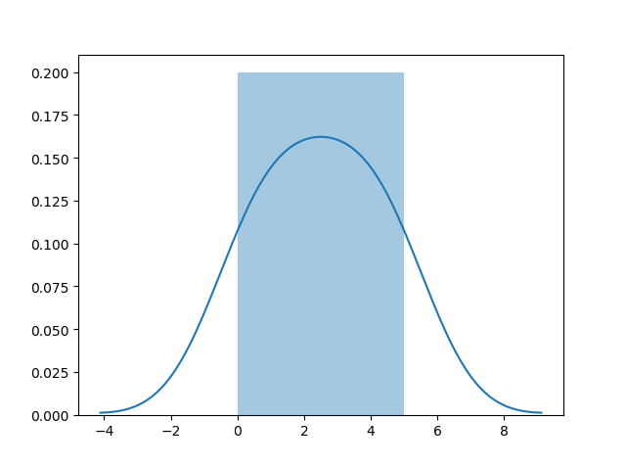
Distplots
import matplotlib.pyplot as plt
import seaborn as sns
sns.distplot([0, 1, 2, 3, 4, 5])
plt.show()

Slide 57
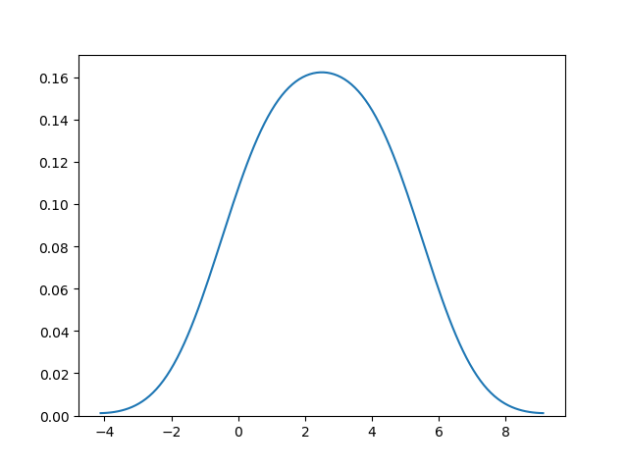
Plotting a Distplot Without the Histogram
import matplotlib.pyplot as plt
import seaborn as sns
sns.distplot([0, 1, 2, 3, 4, 5], hist=False)
plt.show()

